Slide 1

Jessica Bankole: x15766059
Angela Darel: x15021386
Keith Feeney: x15015556
Charlene Moore: x15412048

Slide 2
Project Overview
The Goal of this Project:
Help our seniors be more active in the community by going to events
Provide resources for Medical Support and Education
Background
After much research, the group discovered there is a niche in the market for OAPs to go to events and to assist them in medical and educational support.
What makes it special
There is currently no dedicated website or support for OAPs.
With the number of OAPs increasing, the group thought it was important.

Slide 3
Most difficult implementation part of the project
Visual Studio
Difficult to use
Over-complicated
Database connection to Visual Studio over complicated
Cloud 9
PHP coding / Database connection
Sessions & Cookies

Slide 4
Demonstration
Use cases
Examples of Use Cases
Register a Customer Account
Search Events

Slide 5
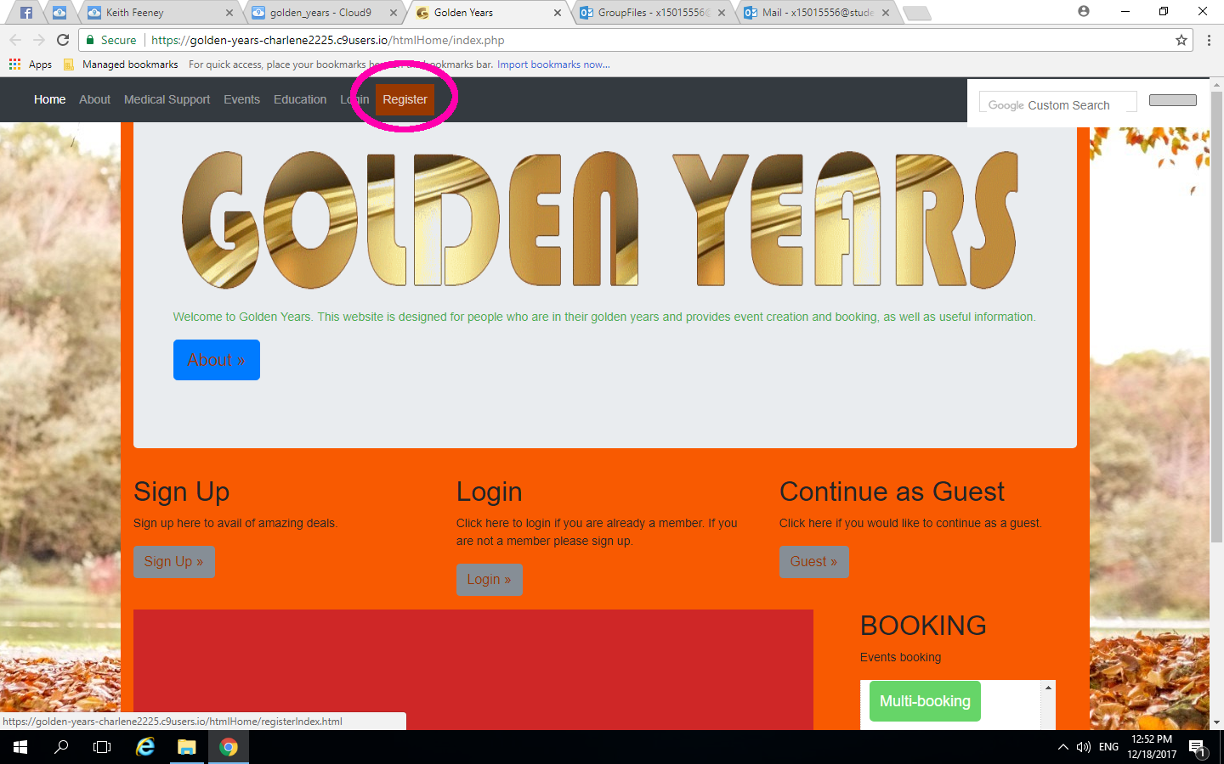
Use Cases: Register a Customer Account (1)
Notes:
This is a brief of how a new user wishes to create a Customer Account.
Users: Customer & System
Pre-condition: User is on the Home Page of Golden Years.
1. User clicks "Register" from the Navigation bar. System redirects user to Register Index page.
2. Customer selects "Customer Account". System redirects to Register Customer Address Page
3. Customer inserts details and Eircode and selects Submit button. System adds data to Database.
4. User selects Continue. System redirects to Register Customer.
5. Customer enters in Eircode and other details and selects Submit.
6. System searches database for Eircode and returns Address ID. Customer account created.

Slide 6
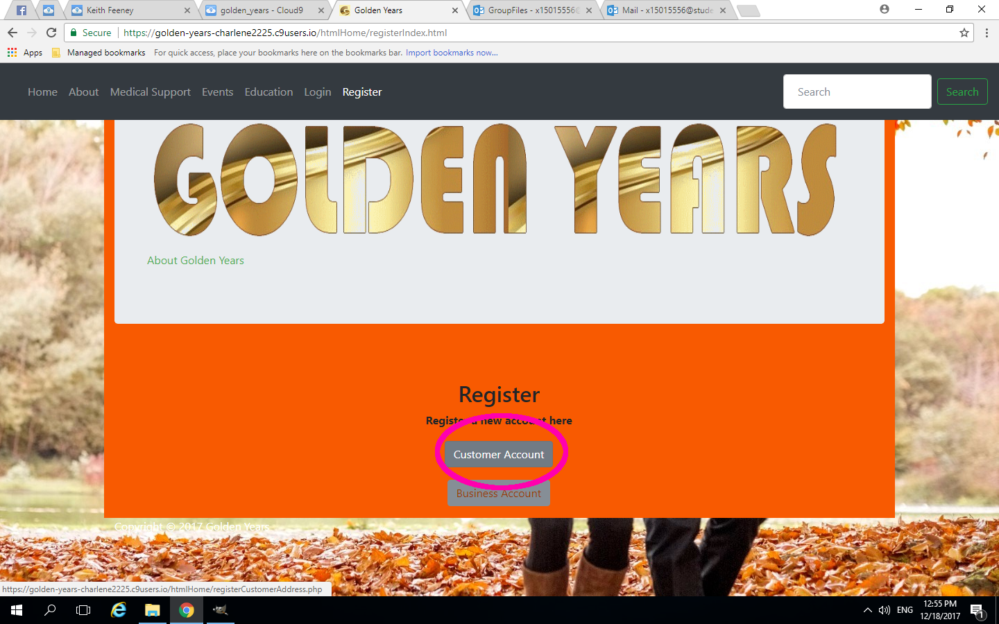
Use Cases: Register a Customer Account (2)
Notes:
This is a brief of how a new user wishes to create a Customer Account.
Users: Customer & System
Pre-condition: User is on the Home Page of Golden Years.
1. User clicks "Register" from the Navigation bar. System redirects user to Register Index page.
2. Customer selects "Customer Account". System redirects to Register Customer Address Page
3. Customer inserts details and Eircode and selects Submit button. System adds data to Database.
4. User selects Continue. System redirects to Register Customer.
5. Customer enters in Eircode and other details and selects Submit.
6. System searches database for Eircode and returns Address ID. Customer account created.

Slide 7
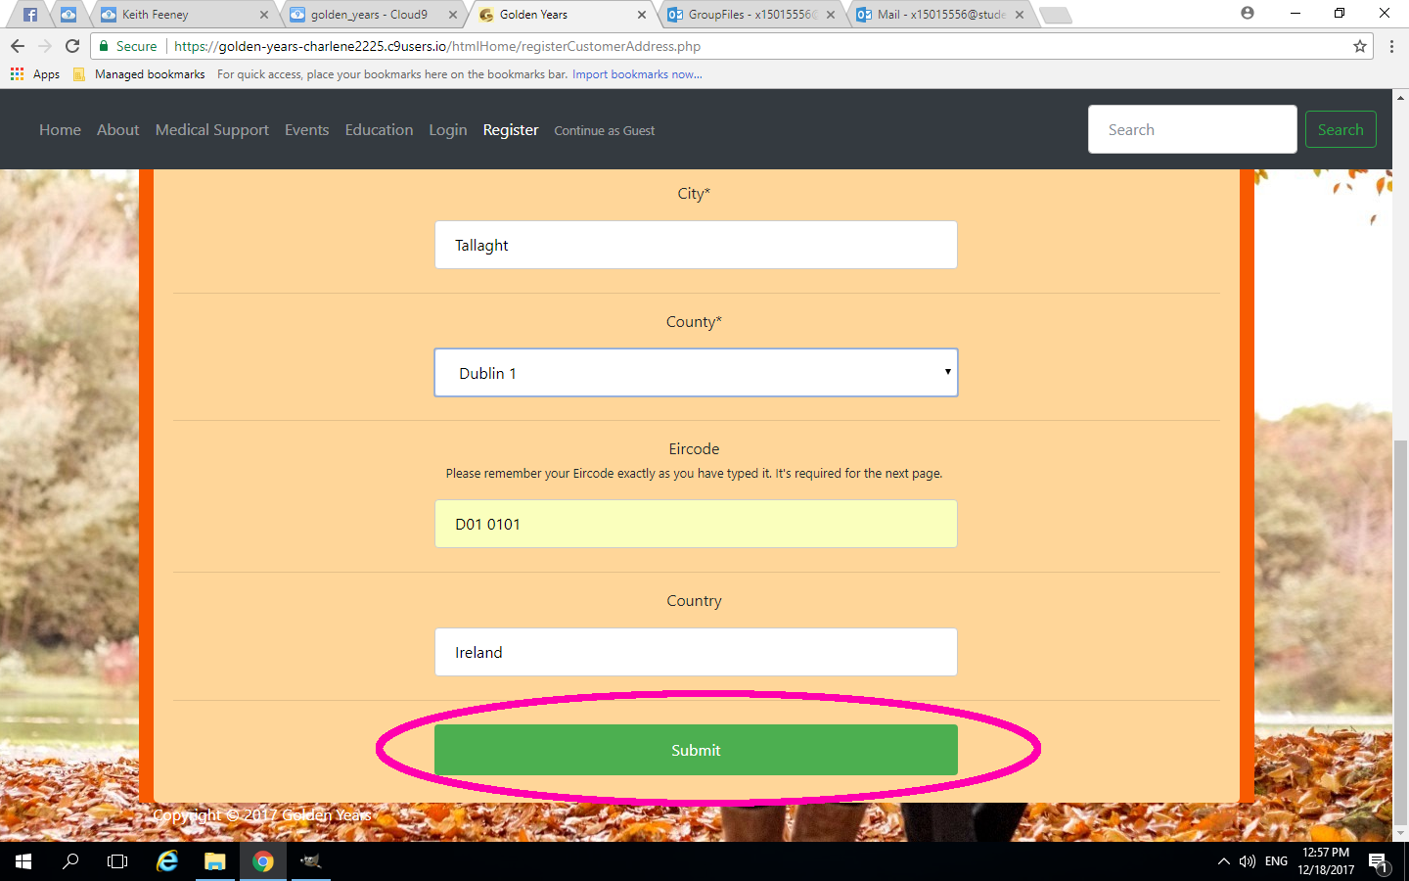
Use Cases: Register a Customer Account (3)
Notes:
This is a brief of how a new user wishes to create a Customer Account.
Users: Customer & System
Pre-condition: User is on the Home Page of Golden Years.
1. User clicks "Register" from the Navigation bar. System redirects user to Register Index page.
2. Customer selects "Customer Account". System redirects to Register Customer Address Page
3. Customer inserts details and Eircode and selects Submit button. System adds data to Database.
4. User selects Continue. System redirects to Register Customer.
5. Customer enters in Eircode and other details and selects Submit.
6. System searches database for Eircode and returns Address ID. Customer account created.

Slide 8
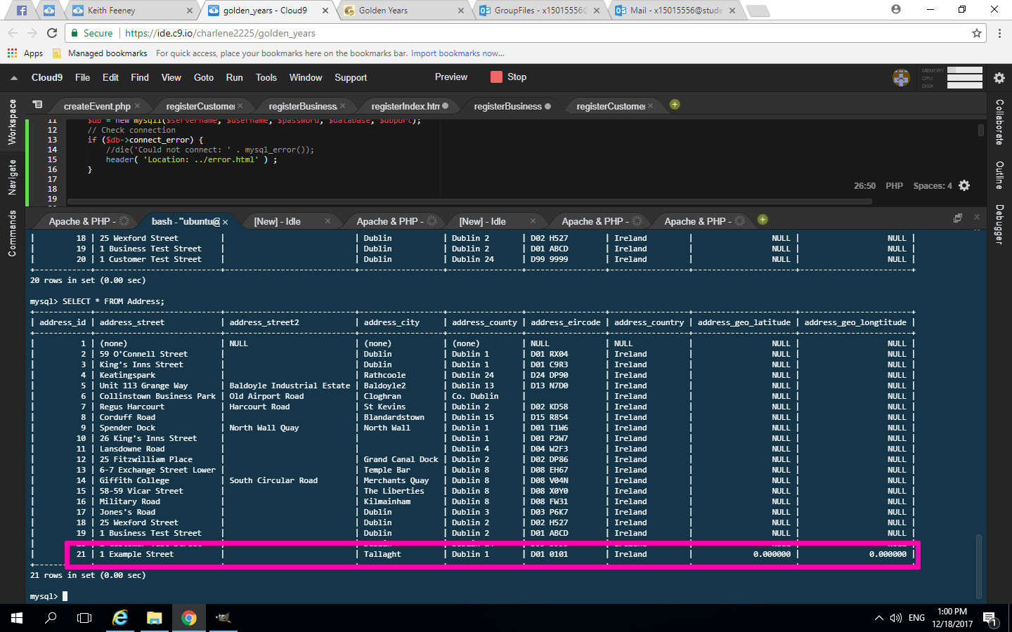
Use Cases: Register a Customer Account (4)
Notes:
This is a brief of how a new user wishes to create a Customer Account.
Users: Customer & System
Pre-condition: User is on the Home Page of Golden Years.
1. User clicks "Register" from the Navigation bar. System redirects user to Register Index page.
2. Customer selects "Customer Account". System redirects to Register Customer Address Page
3. Customer inserts details and Eircode and selects Submit button. System adds data to Database.
4. User selects Continue. System redirects to Register Customer.
5. Customer enters in Eircode and other details and selects Submit.
6. System searches database for Eircode and returns Address ID. Customer account created.

Slide 9
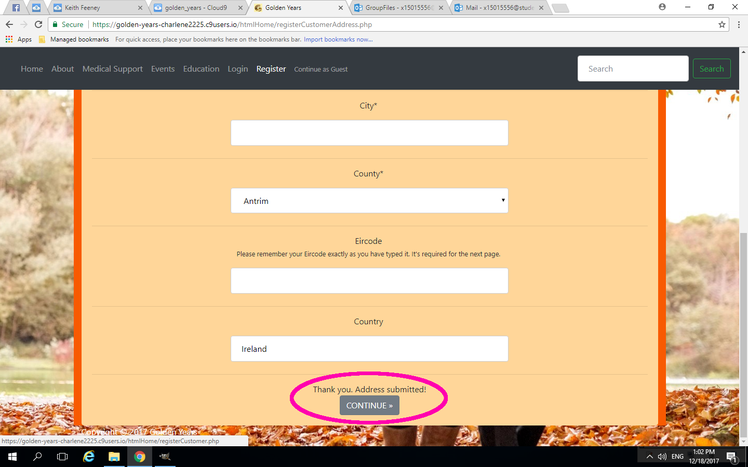
Use Cases: Register a Customer Account (5)
Notes:
This is a brief of how a new user wishes to create a Customer Account.
Users: Customer & System
Pre-condition: User is on the Home Page of Golden Years.
1. User clicks "Register" from the Navigation bar. System redirects user to Register Index page.
2. Customer selects "Customer Account". System redirects to Register Customer Address Page
3. Customer inserts details and Eircode and selects Submit button. System adds data to Database.
4. User selects Continue. System redirects to Register Customer.
5. Customer enters in Eircode and other details and selects Submit.
6. System searches database for Eircode and returns Address ID. Customer account created.

Slide 10
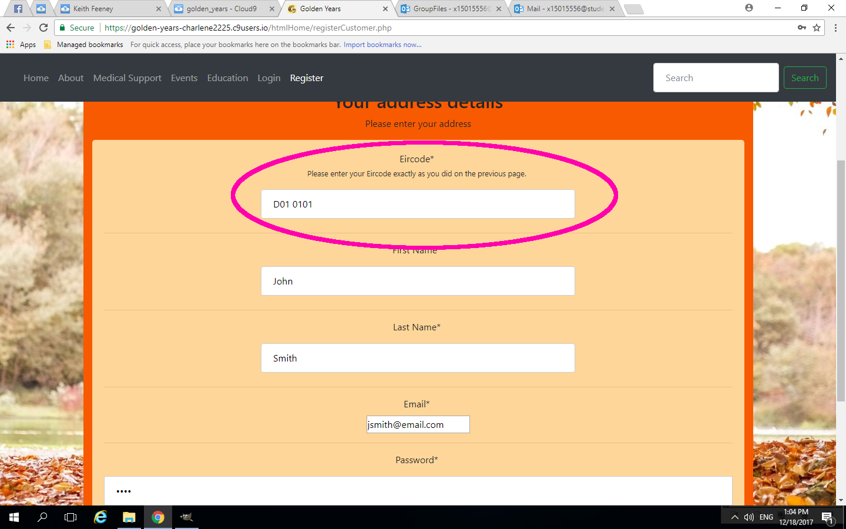
Use Cases: Register a Customer Account (6)
Notes:
This is a brief of how a new user wishes to create a Customer Account.
Users: Customer & System
Pre-condition: User is on the Home Page of Golden Years.
1. User clicks "Register" from the Navigation bar. System redirects user to Register Index page.
2. Customer selects "Customer Account". System redirects to Register Customer Address Page
3. Customer inserts details and Eircode and selects Submit button. System adds data to Database.
4. User selects Continue. System redirects to Register Customer.
5. Customer enters in Eircode and other details and selects Submit.
6. System searches database for Eircode and returns Address ID. Customer account created.

Slide 11
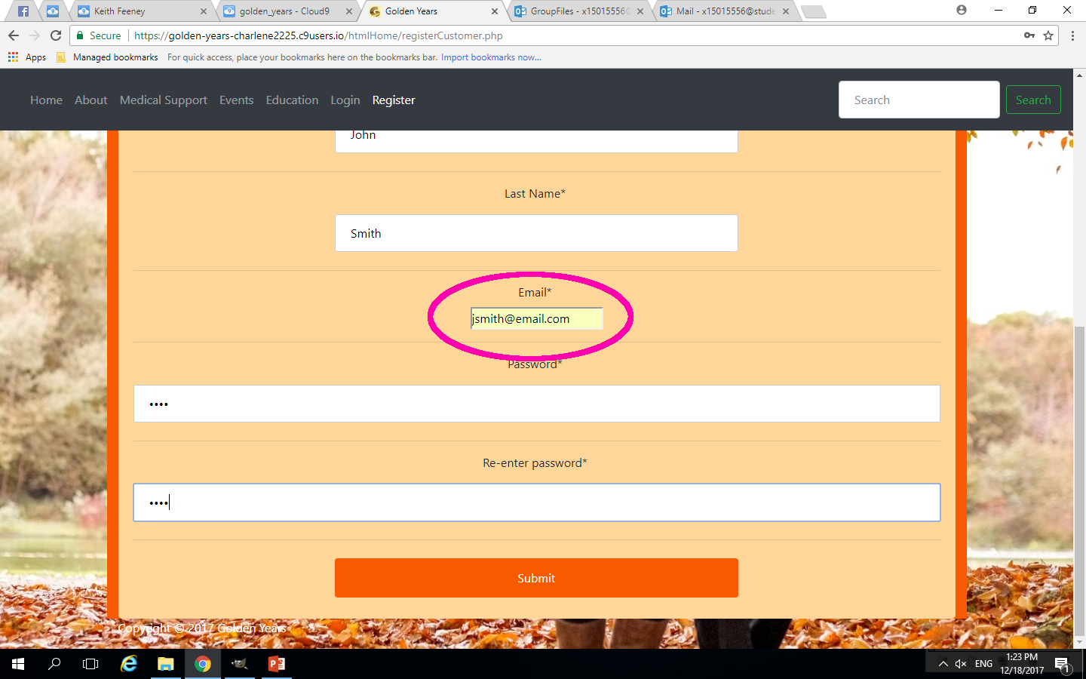
Use Cases: Register a Customer Account (7)
Notes:
This is a brief of how a new user wishes to create a Customer Account.
Users: Customer & System
Pre-condition: User is on the Home Page of Golden Years.
1. User clicks "Register" from the Navigation bar. System redirects user to Register Index page.
2. Customer selects "Customer Account". System redirects to Register Customer Address Page
3. Customer inserts details and Eircode and selects Submit button. System adds data to Database.
4. User selects Continue. System redirects to Register Customer.
5. Customer enters in Eircode and other details and selects Submit.
6. System searches database for Eircode and returns Address ID. Customer account created.

Slide 12
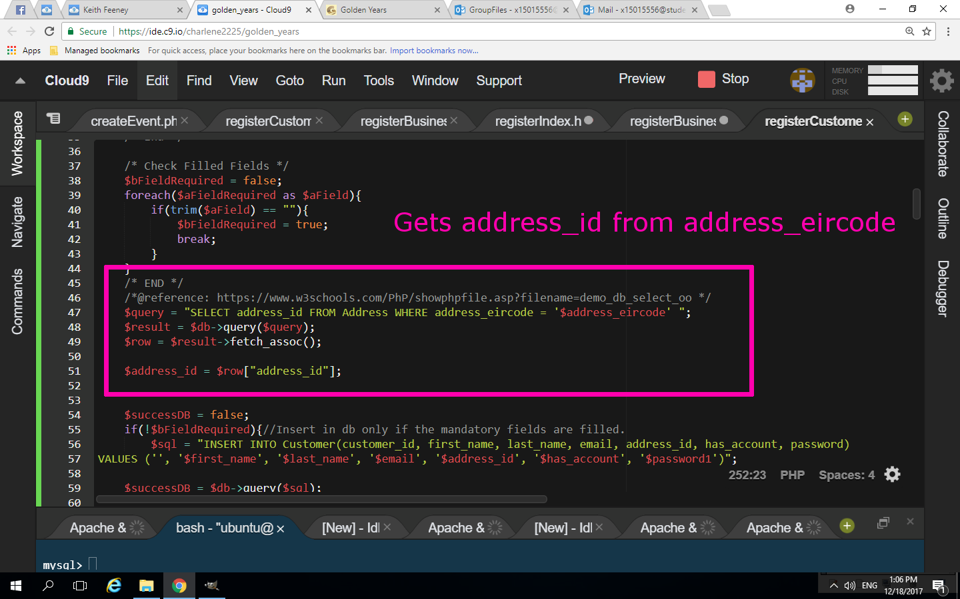
Use Cases: Register a Customer Account (8)
Notes:
This is a brief of how a new user wishes to create a Customer Account.
Users: Customer & System
Pre-condition: User is on the Home Page of Golden Years.
1. User clicks "Register" from the Navigation bar. System redirects user to Register Index page.
2. Customer selects "Customer Account". System redirects to Register Customer Address Page
3. Customer inserts details and Eircode and selects Submit button. System adds data to Database.
4. User selects Continue. System redirects to Register Customer.
5. Customer enters in Eircode and other details and selects Submit.
6. System searches database for Eircode and returns Address ID. Customer account created.

Slide 13
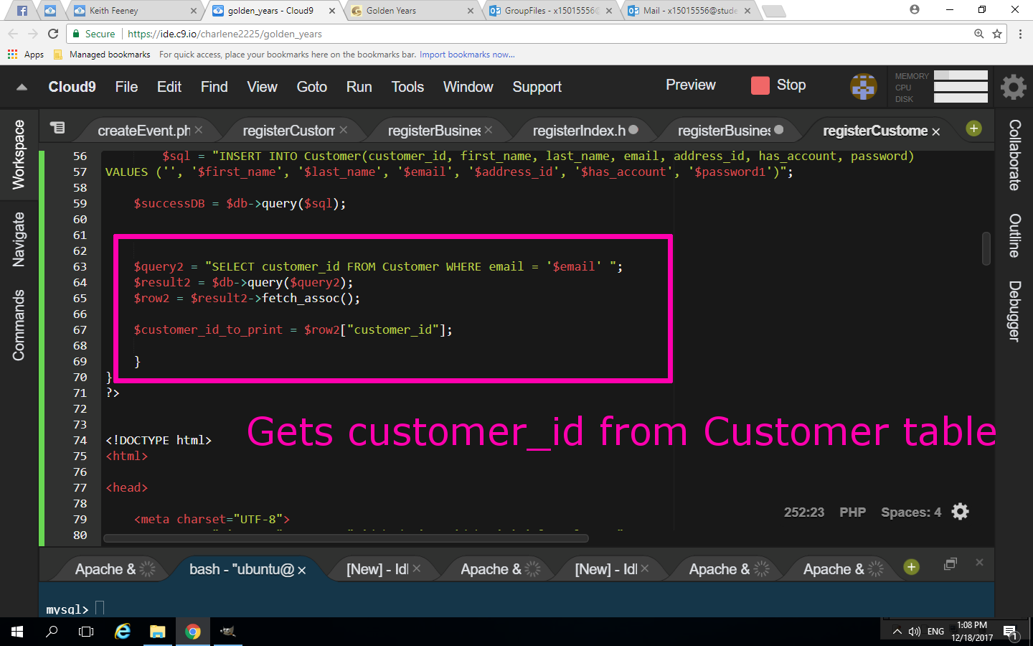
Use Cases: Register a Customer Account (8)
Notes:
This is a brief of how a new user wishes to create a Customer Account.
Users: Customer & System
Pre-condition: User is on the Home Page of Golden Years.
1. User clicks "Register" from the Navigation bar. System redirects user to Register Index page.
2. Customer selects "Customer Account". System redirects to Register Customer Address Page
3. Customer inserts details and Eircode and selects Submit button. System adds data to Database.
4. User selects Continue. System redirects to Register Customer.
5. Customer enters in Eircode and other details and selects Submit.
6. System searches database for Eircode and returns Address ID. Customer account created.

Slide 14
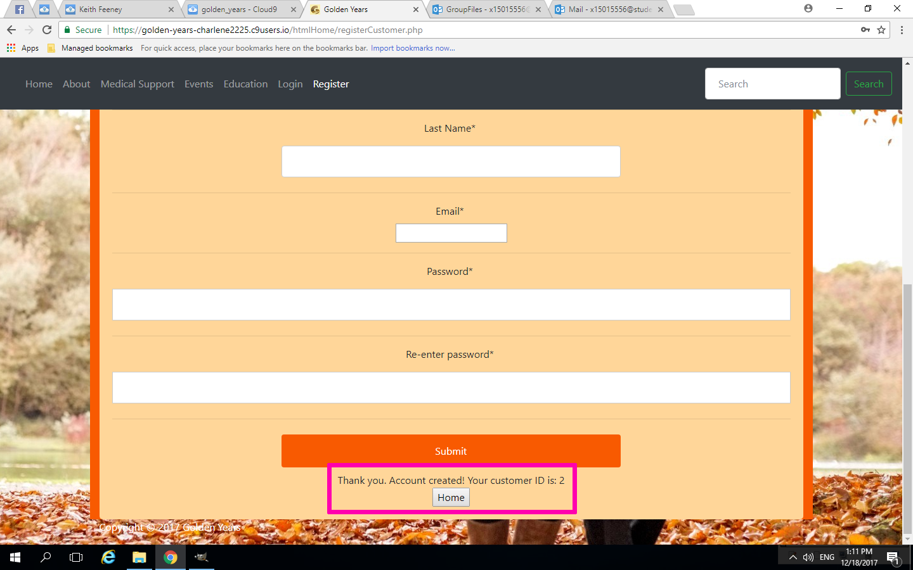
Use Cases: Register a Customer Account (9)
Notes:
This is a brief of how a new user wishes to create a Customer Account.
Users: Customer & System
Pre-condition: User is on the Home Page of Golden Years.
1. User clicks "Register" from the Navigation bar. System redirects user to Register Index page.
2. Customer selects "Customer Account". System redirects to Register Customer Address Page
3. Customer inserts details and Eircode and selects Submit button. System adds data to Database.
4. User selects Continue. System redirects to Register Customer.
5. Customer enters in Eircode and other details and selects Submit.
6. System searches database for Eircode and returns Address ID. Customer account created.

Slide 15
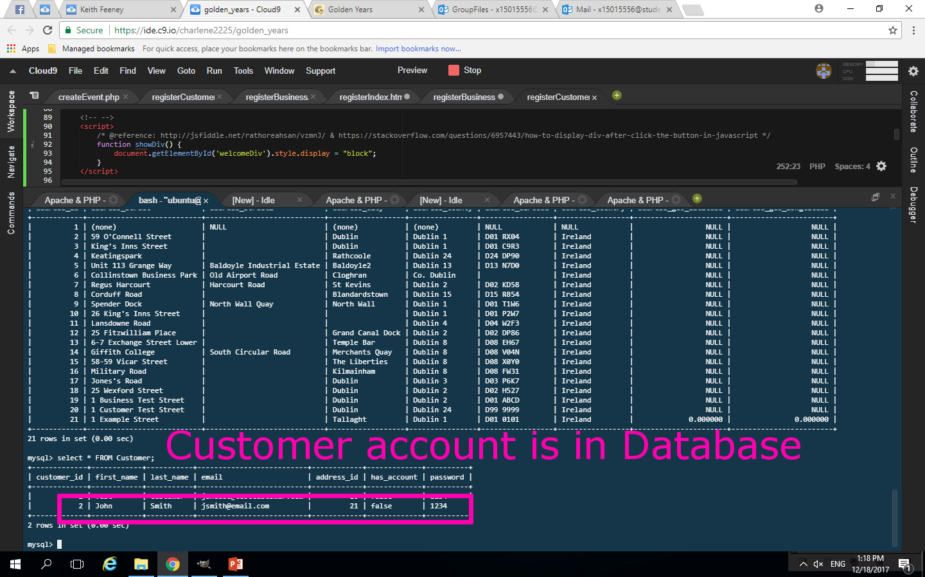
Use Cases: Register a Customer Account (10)
Notes:
This is a brief of how a new user wishes to create a Customer Account.
Users: Customer & System
Pre-condition: User is on the Home Page of Golden Years.
1. User clicks "Register" from the Navigation bar. System redirects user to Register Index page.
2. Customer selects "Customer Account". System redirects to Register Customer Address Page
3. Customer inserts details and Eircode and selects Submit button. System adds data to Database.
4. User selects Continue. System redirects to Register Customer.
5. Customer enters in Eircode and other details and selects Submit.
6. System searches database for Eircode and returns Address ID. Customer account created.

Slide 16
Technologies Used
Outlook Group has been used for file sharing and communication
GitHub has also been used with Git Bash to upload files.
Originally, the Project Started in Visual Studio.
All students were new to Visual Studio. Too complicated for some.
The Web Application then moved to Cloud 9
Simpler, easier to learn and use. Some had previous knowledge of Cloud 9.
Facebook Messenger was also used for communication.

Slide 17
System testing
Cloud 9
An Cloud 9 is an IDE, all testing occurred on Cloud 9.
If there was an issue with the coding, it could be seen instantly.
Client Feedback
Theme was too bright, too orange.
Didn’t like using PayPal, would have preferred internal checkout
More information on Medical and Education pages, like an index, not just external links

Slide 18
Challenges and Achievements
Team Members
Collaboration issues
Failure to communicate
Worked on things unrelated or not asked to do.
Collaboration achievements
Group had meetings to discuss issues
Capable of putting personal issues aside
Project (general)
Issues
Visual Studio
Achievements
Moved to Cloud 9
Last week, the group really all pulled together to get the project complete.

Slide 19
Future Prospects
Mobile Application
Could be created, so users would not need to be at a computer
Further development
Medical and Education pages could be improved, not just link to external sites
Address issues from Client Feedback
The likes of the theme, and a internal checkout could be imposed instead of using PayPal
Search
Create an internal search engine instead of using Google Search.
Partnerships
Partnerships with the likes of the HSE or The Education Training Board (ETB) could be established.

Slide 20
Conclusion
The Group’s view on OAPs has changed to a more positive view
OAPs should have more resources for them to be part of the community.
Golden Years will help OAPs be more active
The Group learned new technologies to assist in making Golden Years more user-friendly.

